Slide 1

B.Tech Project External Evaluation, VIIIth
Internet-Voting System using Blockchain
Presented by :-
Pranav Kumar,2018008769
PraveenAnand,2018011512
Shubh Shukla, 2018006057
Paras Gera, 2018005034
Under the Supervision of:-
Ms. Sonam Nagar
Assistant Professor
Sharda University, Gr. Noida
DEPARTMENT OF COMPUTER SCIENCE & ENGINEERING
SCHOOL OF ENGINEERING AND TECHNOLOGY
May, 2022
1

Slide 2
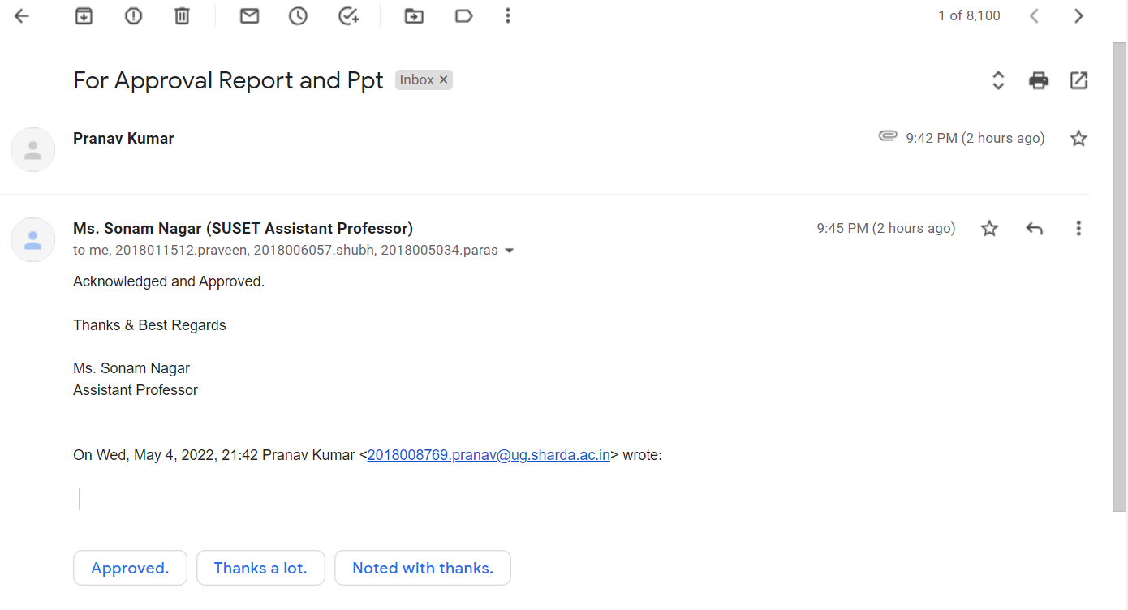
Approval Page

Slide 3
Contents of the Presentation:
Work Load Distribution……………………………………………………………………….....4
Project Planning ………………………………………………………………………................5
Work Done……………………………………………………………….....................................6
Introduction to Blockchain……………………………………………………………………....7
Objective…………………………………………………………………………………………8
Features…………………………………………………………………………………………..9
Proposed System………………………………………………………………………………..10
Voting Procedure For End Users………………………………………………………………..11
Implementation of System……………………………………………………………………...12
Advantage of System…………………………………………………………………………...13
Future Works…………………………………………………………………………………....14
Conclusion………………………………………………………………………………………15
List of Paper Publication……………………………………………………………………......16
References………………………………………………………………………………………17

Slide 4
Work Load Distribution
Name | Work done
Pranav Kumar | Implementation of blockchain (frontend and backend) | Research Papers and Publications in conference
Praveen Anand | Implementation of blockchain (frontend) | Research Papers
Shubh Shukla | Implementation of blockchain (frontend and backend) | Research Papers
Paras Gera | Implementation of blockchain (frontend) | Research Paper

Slide 5
Project Planning
Our project planning model includes of the process that the project team intends to follow to realize the project objectives. It brings together a number of important aspects of this process including its scope, timing and associated risks. Viewed as a type of “contract” between the project team members and the Guide. It defines the process by which objectives will be achieved, and the responsibilities in carrying out this process. It also underpins a number of other key project management functions including estimating and forecasting, options analysis and decision-making, and performance monitoring and control.
The essential elements of a project plan are:
• Scope statement
• Schedule
• Requirements
• Quality criteria

Slide 6
Work Done
The Review of Blockchain for Internet Voting Systems and Open Research Challenges (1st paper) has been accepted by AECE 2022.
Implementation of blockchain for fair pooling system ( 2nd paper) has been published.
Completed our implementation including frontend (React) and backend (Metamask, Solidity).

Slide 7
Introduction of Blockchain
It is a system of recording information in a way that makes it difficult or impossible to change, hack, or cheat the system.
It sometimes referred to as Distributed Ledger Technology (DLT), as each block is distributed among all the nodes in the network.
It makes the history of any digital asset unalterable and transparent through the use of decentralization and cryptographic hashing.
It's structure consists of a chain of blocks, which are nothing but the collections of data and hash.

Slide 8
Objective
Objective is to design and develop a system that would make voting process more secure, transparent, immutable, and reliable.
Overcome the possible issues with the traditional voting systems.
Introduce benefits of Internet-voting along with the highest level of security.
Making the whole system more pocket-friendly and environment-friendly.

Slide 9
Features
Our project have requirements which are drafted at the beginning as per the goals and needs, which should be fulfilled.
Privacy - Keeping an individual’s vote secret.
Check Eligibility - Allowing only registered voters to vote, with each such voter voting only once.
Convenience - Voters must be able to vote easily, and everyone who is eligible must be able to vote.
Verifiability - The ability to trust the vote tallying process.

Slide 10
Proposed System
Authorized voters should be able to vote (equal opportunity about accessibility and place).
Authentication and Validation.
The voter can verify whether their vote has been counted.
The vote(transaction) should be immutable which disallow to tamper and involved the third-party.
Should be able to verify the results.
Should provide admin control.

Slide 11
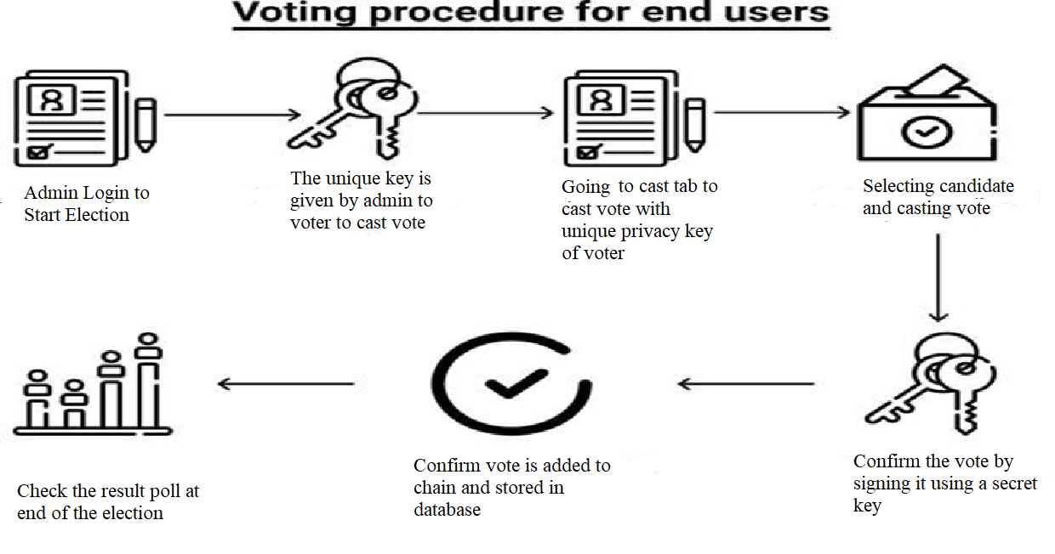
Voting Procedure For End Users

Slide 12
Implementation of the System

Slide 13
Advantage of System
Time Saving for step of election booth in several area.
Workload is reduced.
Information available at time.
It’s provide security for the data.
User Interface is very user friendly.

Slide 14
Future Works
The system can be enhanced in the following ways:
Including a method for verifying Aadhar numbers.
Connecting the program to data from the government's voting system.
Increasing the system's security.
Improving Graphical User Interface (GUI) to make it more user-friendly for both voters and (Election Commission of India) ECI.
Local languages can be incorporated, which will benefit persons living in rural regions as well as the ignorant.
A candidate's previous social work and qualifications might be included to provide a voter with a more informed decision.

Slide 15
Conclusion
These blockchains are controlled independently to eliminate the possibility of votes for certain parties being coordinated and returned to individual voters, while still allowing for the recording of who voted and how many times they voted.
Every voter is a provider with a unique private key and voters will be able to vote once only.
Our solution uses a blockchain to store voter registration information and verify that each voter is unique.
Several additional concerns about openness, confidentiality, and integrity have also been examined as part of the suggested solution, to retain everything as a feature of the system.
After casting a vote the voter will only be able to see the vote count only.

Slide 16
List of Paper Publications
Implementation of blockchain for fair polling system in Information & Communication Technology (ISICT-2022), 01st & 02nd April 2022 in Sharda University, Greater Noida, Uttar Pradesh, India (Published).
Implementation of blockchain for fair polling system in 3rd International Conference on Applied Sciences, Engineering, Technology & Management (ICASETEM-2022) ISBN: 978-93-92105-42-5 . (Accepted).
Implementation of blockchain for fair polling system in 2nd Series of IEEE ICONAT (The International Conference for Intelligent Technologies), Hubballi, Kartakata, India. Host Institution -K. L. E. Institute of Technology, Hubballi (Accepted).
Implementation of blockchain for fair polling system in International Conference on “Contemporary Innovations in Mechanical Engineering” (CIME-2022) (Accepted).
Review of Blockchain for Internet Voting Systems and Open Research Challenges in International Conference on Advancements in Interdisciplinary Research (AIR-2022), 6th- 7th May 2022 Allahabad, Prayagraj (U.P.), India (Accepted).
Review of Blockchain for Internet Voting Systems and Open Research Challenges in IJISRT (International Journal of Innovative Science and Research Technology), ISSN No.: 2456-2165 (Accepted).
Review of Blockchain for Internet Voting Systems and Open Research Challenges in 2nd International conference on Advancement in Electronics & Communication Engineering (AECE-2022) (Accepted).

Slide 17
References
Archit Pandey, Mohit Bhasi and K. Chandrasekaran, “Vote chain: A Blockchain-Based E-Voting System”, 2019 Global Conference for Advancement in Technology (GCAT), INSPEC Accession Number: 19319487, Doi: 10.1109/GCAT47503.2019.8978295.
S. Gopi, B. Giridharan, R. Mohamed Rifoy, S. Sivachidambaram, and S. Yuvaraja, “Effective In-house Voting and Implementation Using Blockchain Verification”, e-ISSN: 2395-0056, vol. 6 Issue: 03 | Mar 2019.
Venkata Naga Rani, Akshay S, Arun Kumar and Ishwar Kumar MA, “Decentralized E-voting System”, p-ISSN: 2395-0072, vol. 6 Issue: 03 | Mar 2019.
Kriti Patidar and Swapnil Jain, “Decentralized E-voting Portal Using Blockchain”, 2019 10th International Conference on Computing, Communication and Networking Technologies (ICCCNT), INSPEC Accession Number: 19277744.
Yash G Gupta, Arun Kushwaha, Amar S Rajeevan, Govind Mahala and Bhagyashree Dhakulkar, “Survey on E-voting Using Blockchain Technology”, CiiT International Journal of Software Engineering and Technology, vol.11, January 2019.
Rashad Rahman “A Secured Electronic Voting System Using Blockchain”, ID: 1404073, Chittagong University of Engineering and Technology, Oct 26, 2018.
Ali Kaan Koç, Emre Yavuz, Umut Can Çabuk and Gökhan Dalkılıç “Towards Secure E-voting Using Ethereum Blockchain”, International Symposium on Digital Forensic and Security (ISDFS), Vol. 6, March 2018.
Mrs. Harsha V Patil, Mrs. Kanchan G Rathi, and Mrs. Malathi V Tribhuwan, “A Study on Decentralized E-Voting System Using Blockchain Technology”, p-ISSN: 2395-0072, vol. 5 Issue: 11 | Nov 2018.
Umut Can Cabuk, Eylül Adıgüzel and Enis Karaarslan, “A Survey on Feasibility and Suitability of Blockchain Techniques for the E-Voting Systems”, IJARCCE, Vol.7, Issue 3, March 2018.
Samuel Agbesi, George Asante, “Electronic Voting Recording System Based on Blockchain Technology”, 12th CMI Conference on Cybersecurity and Privacy (CMI), 29 Nov 2019.

Slide 18
GitHub Repositories Link-https://github.com/PranavKumar8769/Internet-Voting-System-Using-Blockchain-Technology
Thank You All

